Slide 1
QUES - Which category of Family movies is most Rented?
Ans – Animation and Family movies competing but Animation stood up.

Slide 2
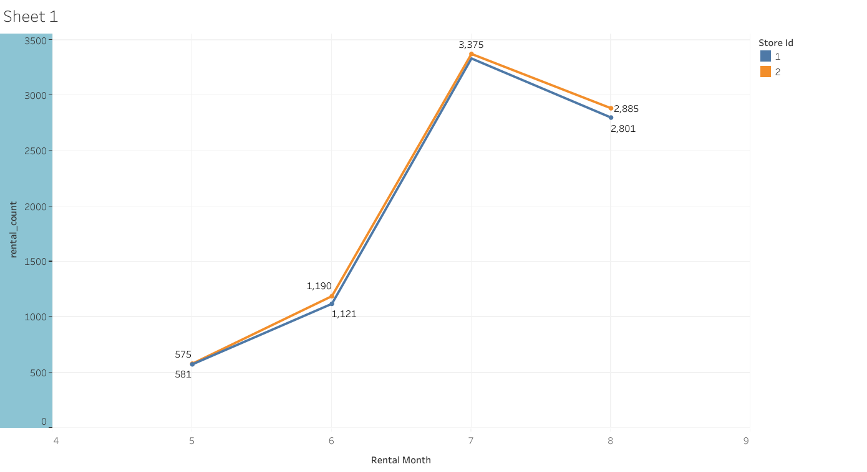
QUES – Compare the rental count of YEAR 2005 of store 1 and 2 .
ANS – STORE 2 has more rentals over the year and highest sales goes on July month

Slide 3
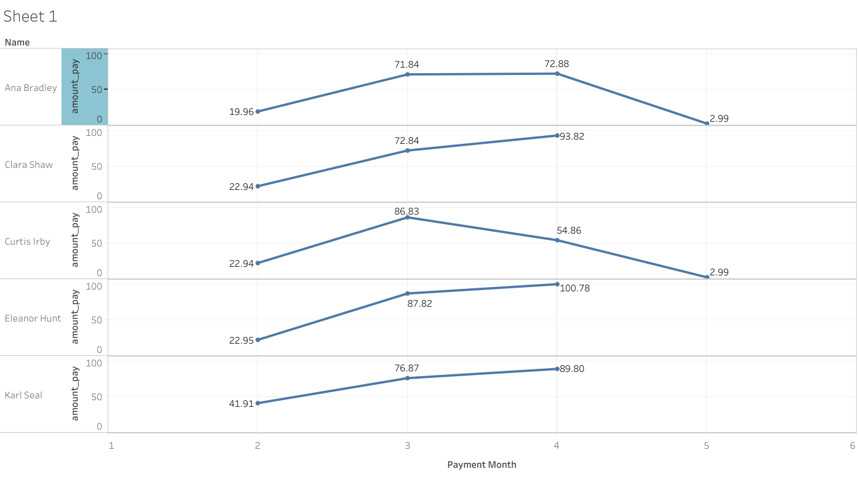
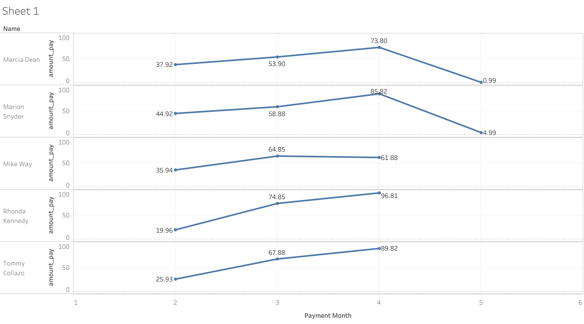
QUES - We would like to know who were our top 10 paying customers, how many payments they made on a monthly basis during 2007, and what was the amount of the monthly payments.

